Slide 1
Materi Kelas X
AY 2022 - 2023

Slide 2
MATERI KELAS X SEMESTER I KD 3
3.1
Mengenal Integrasi Aplikasi Office
3.4
Analisis Data
3.2
Interaksi Perangkat Keras
3.3
Jaringan Komputer

Slide 3
MATERI KELAS X SEMESTER I KD 4
4.1
Mengenal Integrasi Aplikasi Office
4.4
Analisis Data
4.2
Interaksi Perangkat Keras
4.3
Jaringan Komputer

Slide 4
3.1 Teori Integrasi Antar Aplikasi Office 4.1 PraktikIntegrasi Antar Aplikasi Office
Alat dan Bahan
Proses Pembelajaran
Aplikasi Pengolah Kata Office.
Aplikasi Pengolah Presentasi Office.
GitHub.
Pembelajaran dilakukan didalam LabKomputer.
Bagian ini membahas Expert Function dari Aplikasi Office secara khusus dalam pembuatan Karya Tulis Ilmiah.

Slide 5
3.2 Interaksi Antar Perangkat Keras 4.2 Interaksi Antar Perangkat Keras
Alat dan Bahan
Proses Pembelajaran
Aplikasi Pengolah Angka Office.
GitHub.
Pembelajaran dilakukan didalam LabKomputer.
Mempelajari LIFO dan FIFO dalam proses pengurutan sistem operasi.
Mempelajari Stack dan Queue dalam proses pengurutan sistem operasi.

Slide 6
3.3 Teori Jaringan Komputer 4.3 Praktik Jaringan Komputer
Alat dan Bahan
Proses Pembelajaran
Aplikasi Pengolah Sistem Jaringan.
GitHub.
Pembelajaran dilakukan didalam LabKomputer.
Sistem jaringan dan prosesnya.
Prototyping Jaringan.

Slide 7
3.4 Teori Analisis Data 4.4 Praktik Analisis Data
Alat dan Bahan
Proses Pembelajaran
Aplikasi Pengolah Database atau Aplikasi Sejenis.
GitHub.
Pembelajaran dilakukan didalam LabKomputer.
Proses Pengumpulan Data.
Proses Mengolah dan Menampilkan Data.

Slide 8

Pengenalan Version Control System (VCS)
GitHub adalah layanan hos web bersama untuk proyek pengembangan perangkat lunak yang menggunakan sistem kendali versi Git dan layanan hosting internet. Hal ini banyak digunakan untuk kode komputer. Ini memberikan kontrol akses dan beberapa fitur kolaborasi seperti pelacakan bug, permintaan fitur, manajemen tugas, dan wiki untuk setiap proyek.
GitHub menawarkan paket repositori pribadi dan gratis pada akun yang sama dan digunakan untuk proyek perangkat lunak sumber terbuka. Pada bulan April 2017, GitHub melaporkan bahwa mereka mempunyai lebih dari 20 juta pengguna dan lebih dari 57 juta repository, menjadikannya layanan terbesar dari kode sumber di dunia.
Sumber : WikiPedia.

Slide 9
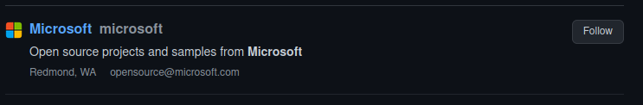
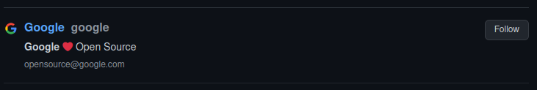
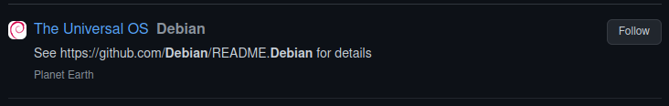
Perusahaan Yang Menggunakan GitHub

Slide 10
MATERI KELAS X SEMESTER
3.1
Mengenal Integrasi Aplikasi Office
04
Compact the model
Despite being red, Mars is a cold place
3.2
Interaksi Perangkat Keras
Convert the model
05
Saturn is the only planet with rings
3.3
Jaringan Komputer
06
Integrate the model
Jupiter is the biggest planet of them all

Slide 11
Machine Learning Infographics
Spam filtering
Mercury is the closest planet to the Sun
Some machine learning applications
Mobile banking
The Earth is the planet where we all live
Risk assessment
Despite being red, Mars is a cold place
Social networks
Jupiter is the biggest planet of them all

Slide 12
Machine Learning Infographics
01
02
Venus
Mercury
Venus has a beautiful name, but it’s hot
Mercury is the closest planet to the Sun

Slide 13
Machine Learning Infographics
01
02
Mercury
Venus
Mercury is the closest planet to the Sun
Machine learning
Venus has a beautiful name, but it’s hot
Yes, Saturn is a gas giant that has several rings
03
04
Earth
Mars
The Earth is the third planet from the Sun
Despite being red, Mars is a cold place

Slide 14
Machine Learning Infographics
Machine learning
Mars
04
Saturn is the gas giant that has rings
Despite being red, Mars is a cold place
Venus
03
Venus has a beautiful name, but it’s hot
Mercury
02
Mercury is the closest planet to the Sun
Earth
01
The Earth is the third planet from the Sun

Slide 15
Machine Learning Infographics
01
Power
AI
Memory
02
Mercury is the closest planet to the Sun
Neptune is the farthest planet from the Sun
System configuration
03
Memory
Mars
04
Jupiter is a gas giant and the biggest planet
Despite being red, Mars is a cold place
05
Security
FPGA
06
Venus has a beautiful name, but it’s hot
Pluto is considered a dwarf planet
07
MCU
Wireless
08
The Earth is the third planet from the Sun
Ceres is located in the main asteroid belt

Slide 16
Machine Learning Infographics
Artificial intelligence
Mercury is the closest planet to the Sun
Machine learning
Jupiter is a gas giant and the biggest planet
Deep learning
Venus has a beautiful name, but it’s hot

Slide 17
Machine Learning Infographics
Output unit
Neural network
Yes, Saturn is a gas giant that has rings
01
Output layer
02
Input layer
Input unit 1
Input unit 2

Slide 18
Machine Learning Infographics
01
02
03
04
1950s
1960s
1970s
1980s
Simple algorithms
Bayesian methods
AI winter caused by pessimism
Resurgence in ML research
Mercury is the closest planet to the Sun
Jupiter is a gas giant and the biggest planet
Venus has a beautiful name, but it’s very hot
Mercury is the closest planet to the Sun
05
06
07
1990s
2000s
2010s
Data-driven approach
Support-Vector Clustering
Deep learning popularity
The Earth is the third planet from the Sun
Ceres is located in the main asteroid belt
Venus has a beautiful name, but it’s very hot

Slide 19
Machine Learning Infographics
Continuous improvement
Machine learning disadvantages
01
Despite being red, Mars is a cold place
Data acquisition
02
Venus has a beautiful name, but it’s hot
Patterns identification
03
Mercury is the closest planet to the Sun
Time and resources
04
The Earth is the third planet from the Sun

Slide 20
Machine Learning Infographics
01
02
Image recognition
Customization
The Earth is the planet where we live
Despite being red, Mars is a cold place
03
04
Voice recognition
Opportunities of machine learning
Data analysis
Venus has a beautiful name, but it’s hot
The Earth is the third planet from the Sun
05
06
Optical recognition
Memory data
Mercury is the closest planet to the Sun
Pluto is considered a dwarf planet

Slide 21
Machine Learning Infographics
Machine learning
The model
Venus has a beautiful name, but it’s hot
Despite being red, Mars is a cold place
Input 1
Input 2
The Earth is the third planet from the Sun
Mercury is the closest planet to the Sun

Slide 22
Machine Learning Infographics
01 | Supervised learning
 | Venus has a beautiful name, but it’s hot
02 | Unsupervised learning
 | Despite being red, Mars is a cold place
03 | Semi-supervised learning
 | The Earth is the third planet from the Sun
04 | Reinforcement learning
 | Mercury is the closest planet to the Sun
05 | Dimensionality reduction
 | Pluto is considered a dwarf planet

Slide 23
Machine Learning Infographics
01
Active learning
Maturation
02
Mercury is the closest planet to the Sun
Jupiter is a gas giant and the biggest planet
03
Motor synergies
Imitation
04
The Earth is the planet where we live
Despite being red, Mars is a cold place

Slide 24
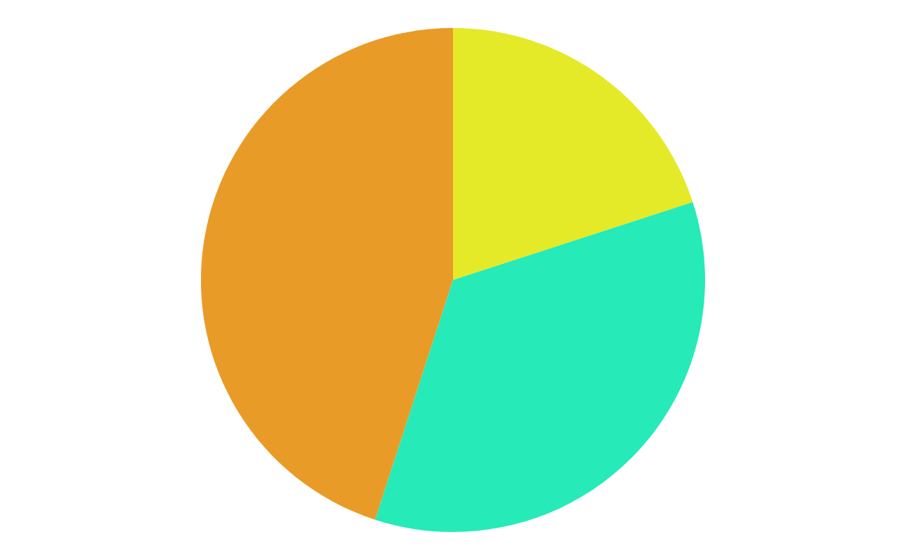
Machine Learning Infographics
45%
20%
Data mining
Intrusion detection
The Earth is the third planet from the Sun
Mercury is the closest planet to the Sun
35%
Continuous production
Despite being red, Mars is a very cold place
Follow the link in the graph to modify its data and then paste the new one here. For more info, click here

Slide 25
Machine Learning Infographics
01
Classify data
Mercury is the closest planet to the Sun
Machine learning objectives
02
Make predictions
The Earth is the planet where we live

Slide 26
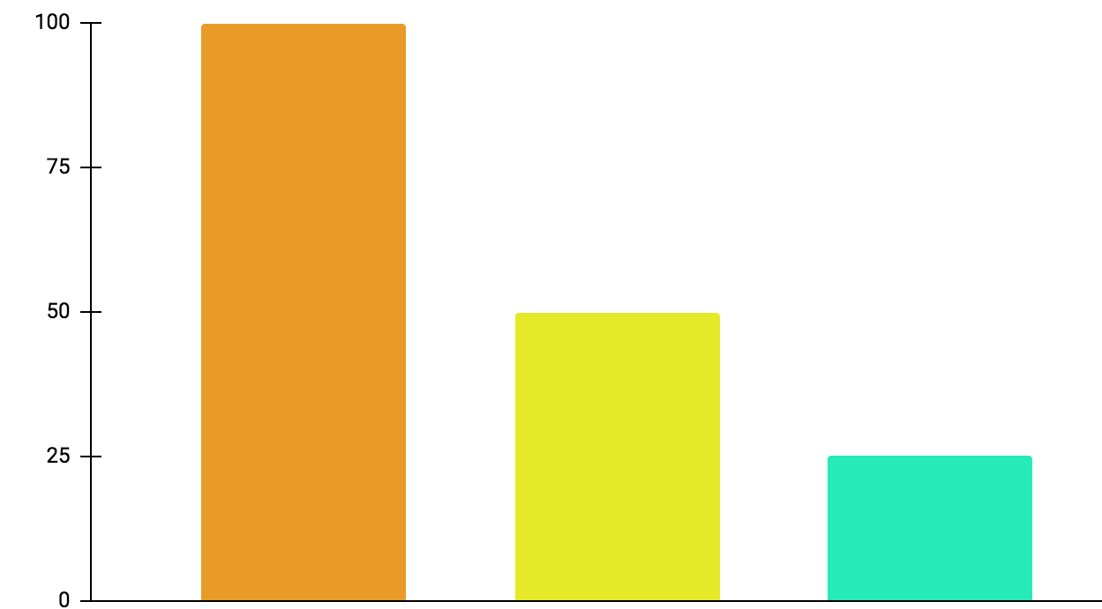
Machine Learning Infographics
01
Active learning
Mercury is the closest planet to the Sun
02
Maturation
Jupiter is a gas giant and the biggest planet
03
Motor synergies
Neptune is very far away from the Sun
100%
50%
25%
Follow the link in the graph to modify its data and then paste the new one here. For more info, click here

Slide 27
Machine Learning Infographics
Models
Artificial neural networks | The Earth is the planet we live on
Decision trees | Mercury is the smallest planet
Support-vector machines | Despite being red, Mars is a cold place
Regression analysis | Jupiter is the biggest planet of them all
Bayesian networks | Venus has a beautiful name
Genetic algorithms | Pluto is considered a dwarf planet

Slide 28
Machine Learning Infographics
Collect the data
Prepare the data
Mercury is the closest planet to the Sun
The Earth is the third planet from the Sun
Train a model
Despite being red, Mars is a cold place
Improve
Evaluate the model
Pluto is considered a dwarf planet
Jupiter is the biggest planet of them all

Slide 29
Machine Learning Infographics
Inputs
Outputs
Mercury is the closest planet to the Sun
Jupiter is a gas giant and the biggest planet
Input 1
Output 1
Input 2
Output 2
Input 3
Output 3

Slide 30
Machine Learning Infographics
Supervised learning
Unsupervised learning
Reinforcement learning
Classification
Reduction
Fraud detection
Email spam detection
Diagnostics
Image classification
Text mining
Data visualization
Face detection
Voice detection
Finances
Manufacturing
Stock management
Autonomous cars
Regression
Regression
Risk assessment
Score prediction
City planning
Targeted marketing

Slide 31
Machine Learning Infographics
Predict trends
01
02
Innovation
Venus has a beautiful name, but it’s hot
Despite being red, Mars is a cold place
Target segmentation
03
Cost reduction
04
Mercury is the closest planet to the Sun
Neptune is very far away from the Sun
Advert segmentation
05
06
Customer relations
ML for business
The Earth is the third planet from the Sun
Jupiter is the biggest planet of them all

Slide 32
Machine Learning Infographics
Machine learning application example
Polite
Offensive
01
02
03
04
Tweet
Feature engineering
Classification
Output
Mercury is the closest planet to the Sun
Venus has a beautiful name, but it’s hot
The Earth is the third planet from the Sun
Despite being red, Mars is a cold place

Slide 33
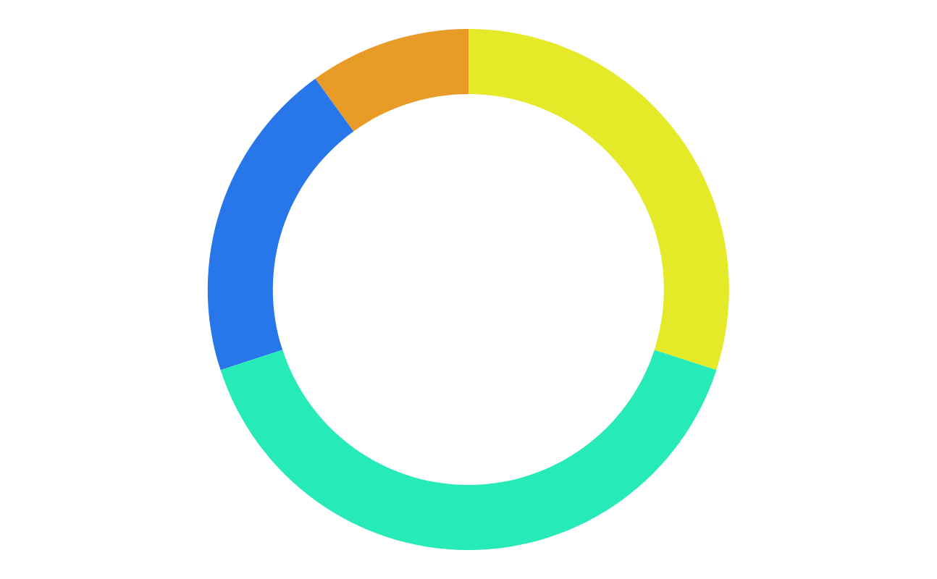
Machine Learning Infographics
10%
30%
Mercury
Jupiter
Mercury is the closest planet to the Sun
Jupiter is a gas giant and the biggest planet
20%
40%
Neptune
Mars
It’s the farthest planet from the Sun
Despite being red, Mars is a cold place
Follow the link in the graph to modify its data and then paste the new one here. For more info, click here

Slide 34
Machine Learning Infographics
Biochemical analysis
Disease diagnosis
Drug discovery
Mercury is the closest planet to the Sun
Venus has a beautiful name, but it’s hot
The Earth is the third planet from the Sun

Slide 35
Machine Learning Infographics
 | Common Uses for Machine Learning
01 | Chatbot systems | Venus has a beautiful name, but it’s hot
02 | Decision support | Mercury is the closest planet to the Sun
03 | Customer recommendation engines | The Earth is the third planet from the Sun
04 | Customer churn modeling | Despite being red, Mars is a cold place
05 | Pricing strategies | Neptune is the farthest planet from the Sun
06 | Customer segmentation | Jupiter is the biggest planet of them all
07 | Image classification | Pluto is now considered a dwarf planet

Slide 36
Machine Learning Infographics
Input data
Neptune
Mars
It’s the farthest planet from the Sun
Despite being red, Mars is a cold place
Learning system
Mercury is the closest planet to the Sun
Output data

Slide 37
Machine Learning Infographics
Machine learning advantages vs disadvantages
Advantages
Disadvantages
Efficiency data managing
Continuous improvement
Lots of applications
Trend identification
Pattern identification
Data acquisition
Time and space
Time-consuming
High error possibilities
Algorithm selection

Slide 38
Machine Learning Infographics
01
02
03
Identify data
Choose algorithm
Analytical model
Venus has a beautiful name, but it’s hot
Mercury is the closest planet to the Sun
Despite being red, Mars is a cold place
04
05
Train the model
Run the model
Jupiter is the biggest planet of them all
Neptune is very far away from the Sun

Slide 39
Machine Learning Infographics
Input data
Jupiter is the biggest planet of them all
Relationships
Patterns
Machine learning
Algorithms + techniques
Dependencies
Structures
Output
Despite being red, Mars is a cold place

Slide 40
Instructions for use
In order to use this template, you must credit Slidesgo in your final presentation.
You are allowed to:
- Modify this template.
- Use it for both personal and commercial projects.
You are not allowed to:
- Sublicense, sell or rent any of Slidesgo Content (or a modified version of Slidesgo Content).
- Distribute Slidesgo Content unless it has been expressly authorized by Slidesgo.
- Include Slidesgo Content in an online or offline database or file.
- Offer Slidesgo templates (or modified versions of Slidesgo templates) for download.
- Acquire the copyright of Slidesgo Content.
For more information about editing slides, please read our FAQs or visit Slidesgo School:
https://slidesgo.com/faqs and https://slidesgo.com/slidesgo-school

Slide 41
Instructions for use (premium users)
In order to use this template, you must be a Premium user on Slidesgo.
You are allowed to:
Modify this template.
Use it for both personal and commercial purposes.
Hide or delete the “Thanks” slide and the mention to Slidesgo in the credits.
Share this template in an editable format with people who are not part of your team.
You are not allowed to:
Sublicense, sell or rent this Slidesgo Template (or a modified version of this Slidesgo Template).
Distribute this Slidesgo Template (or a modified version of this Slidesgo Template) or include it in a database or in any other product or service that offers downloadable images, icons or presentations that may be subject to distribution or resale.
Use any of the elements that are part of this Slidesgo Template in an isolated and separated way from this Template.
Register any of the elements that are part of this template as a trademark or logo, or register it as a work in an intellectual property registry or similar.
For more information about editing slides, please read our FAQs or visit Slidesgo School:
https://slidesgo.com/faqs and https://slidesgo.com/slidesgo-school

Slide 42
Infographics
You can add and edit some infographics to your presentation to present your data in a visual way.
Choose your favourite infographic and insert it in your presentation using Ctrl C + Ctrl V or Cmd C + Cmd V in Mac.
Select one of the parts and ungroup it by right-clicking and choosing “Ungroup”.
Change the color by clicking on the paint bucket.
Then resize the element by clicking and dragging one of the square-shaped points of its bounding box (the cursor should look like a double-headed arrow). Remember to hold Shift while dragging to keep the proportions.
Group the elements again by selecting them, right-clicking and choosing “Group”.
Repeat the steps above with the other parts and when you’re done editing, copy the end result and paste it into your presentation.
Remember to choose the “Keep source formatting” option so that it keeps the design. For more info, please visit Slidesgo School.

